Slide 1


Lesson 16
I was crazy about John
UNIT 3

Slide 2



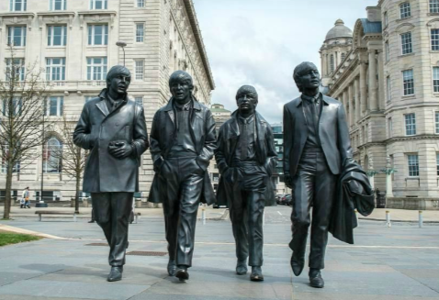
Listen to this song.
Do you know whose song it is?
Have you ever heard about The Beatles?
Today you are going to learn more about one of the most famous English rock band formed in Liverpool. The band which changed the history of music.

Slide 3
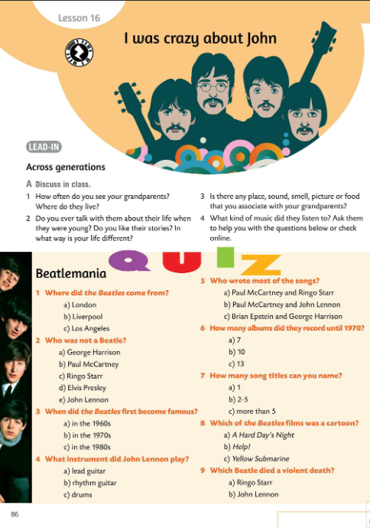
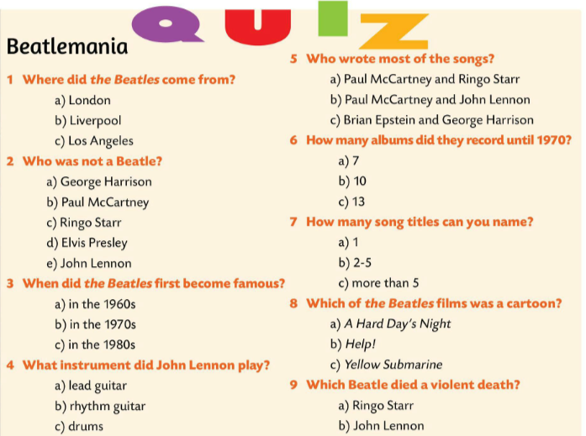

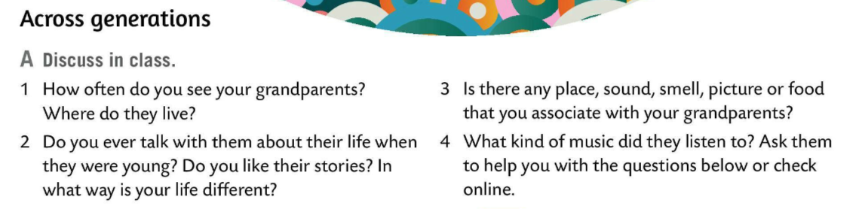
Do Task A. Read and ask your partner the questions. Write down his/her responses. Discuss in class.
Do the quiz and find out how much you know about the Beatles.
Check.
Use the dictionary. Find the meaning of the following words:
be keen on, lyrics, beat, drums, rhythm guitar, lead guitar, keyboards, vocals.
Check in class.

Slide 4
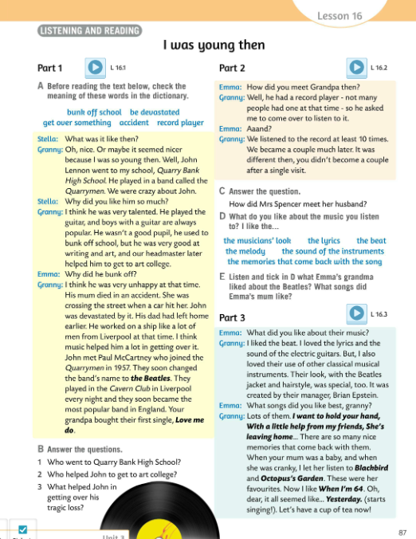
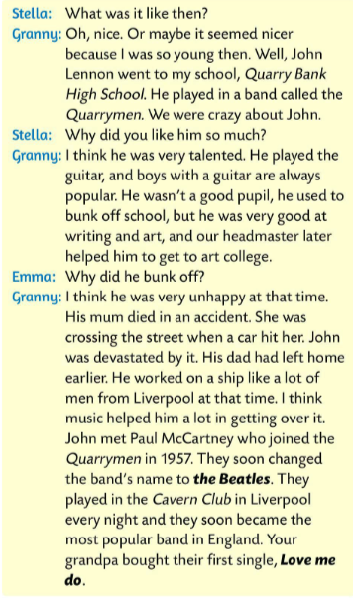
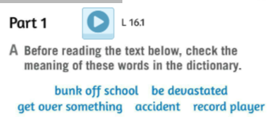
Before reading, check the meaning of these words.
bunk off school – markirati iz škole
be devastated – biti shrvan
get over something – preboljeti nešto
accident – nesreća
record player – gramofon
Listen to the recording and then read the text.

Slide 5
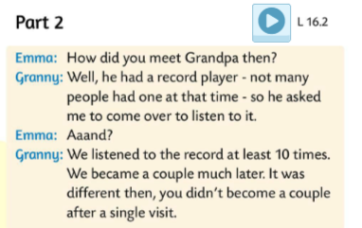
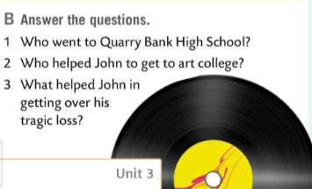
Read the text once again and answer the questions.
Check.
1 John Lennon went to Quarry Bank High School.
2 Headmaster helped John to get to art college.
3 Music helped John in getting over his loss.
Listen to the recording and read the second part of the dialogue.

Slide 6
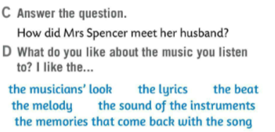
Listen to the recording again and answer the question in Task C.
Check.
Mrs Spencer met her husband when he asked her to come over to his place to listen to the Beatles. He had a record player and not many people had one at the time.

Slide 7
What do you like about the music you listen to?
Think about what is important. Use the words in blue in Task D and say:
I like…
the musician’s look – izgled pjevača
the lyrics – tekst pjesme
the beat – ritam
the melody – melodiju
the sound of the instruments – zvuk instrumenata
the memories that come back with the song – sjećanja koja vežeš uz pjesmu

Slide 8
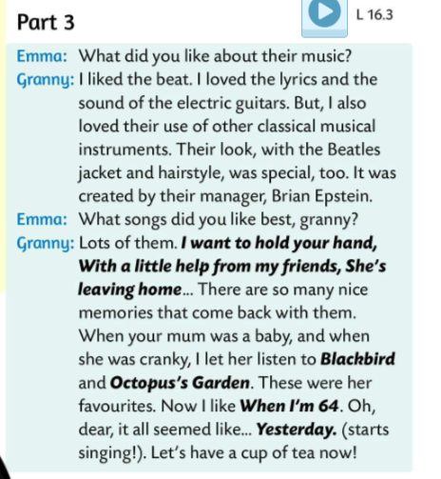
Do Task D. Listen and tick what Emma’s grandma liked about the Beatles? What songs did Emma’s mum like?
Check.
Emma’s grandma likes the beat, the lyrics, and the sound of the electric guitars.
Emma’s mum liked Blackbird and Octopus’s Garden.

Slide 9
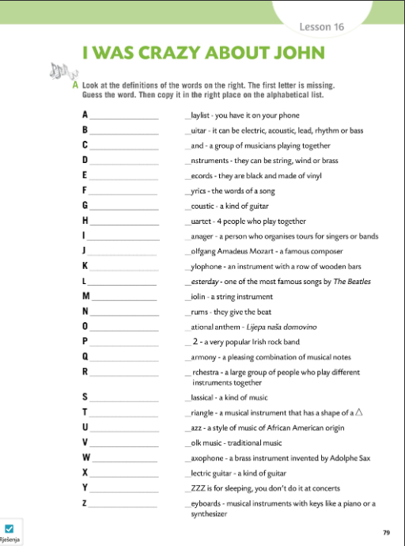
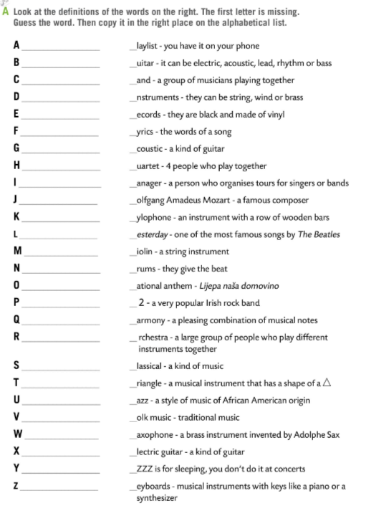

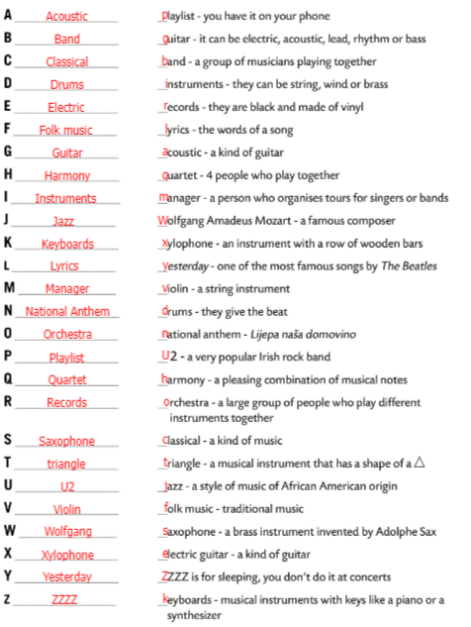
Workbook page 79.
Look at the definitions on the right.
The first letter is missing.
Guess the word.
Copy it in the right place on the alphabetical list.
Check.

Slide 10
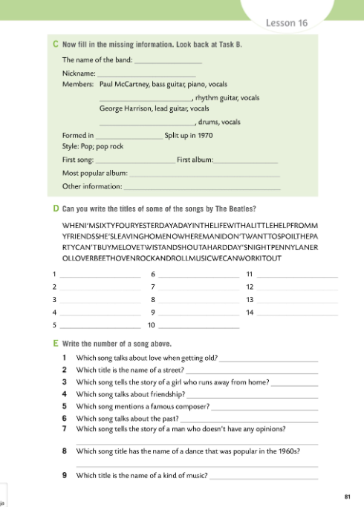
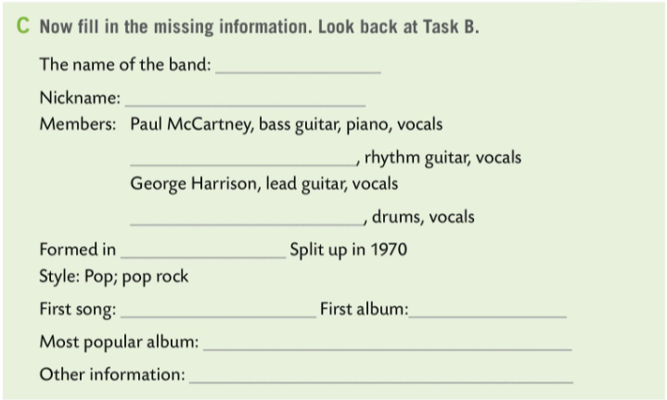
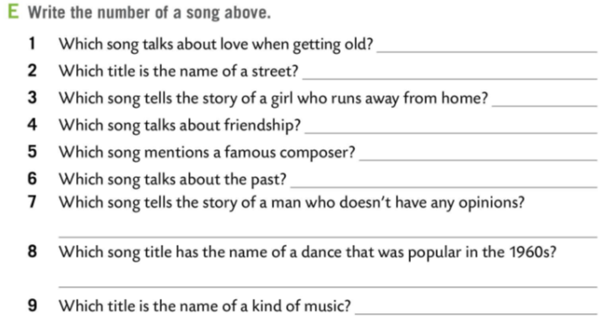
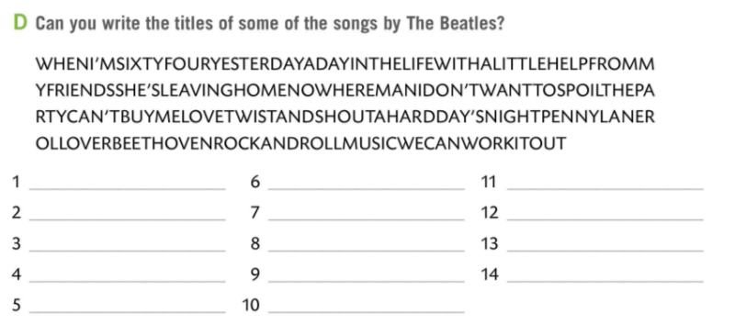
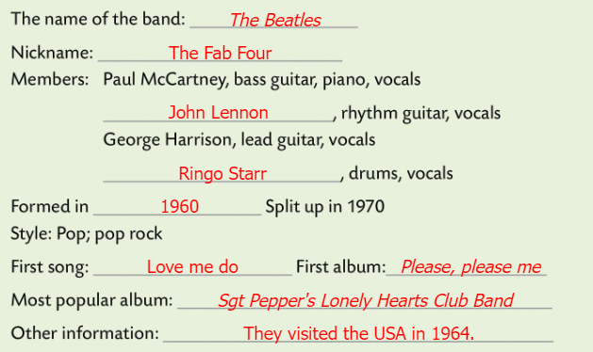
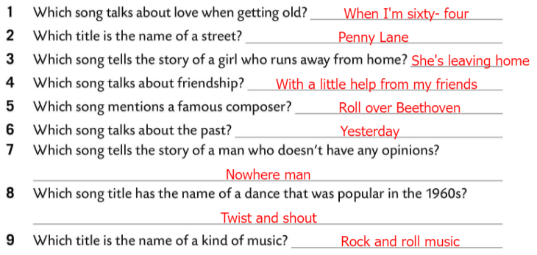
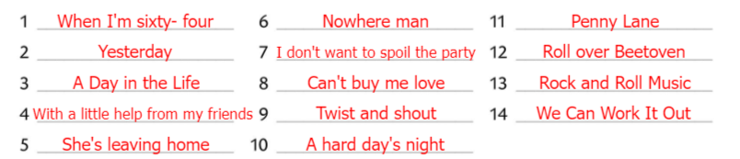
Workbook page 81.
Fill in the missing information in Task C. Look back at Task B.
Check.
Can you write the titles of some of the songs by the Beatles in Task D?
Check.
Write the number of a song in Task E. Look back at Task D.
Check.

Slide 11
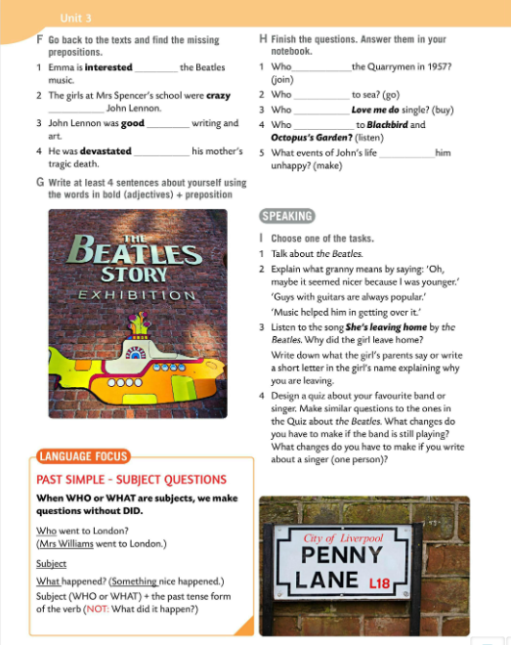
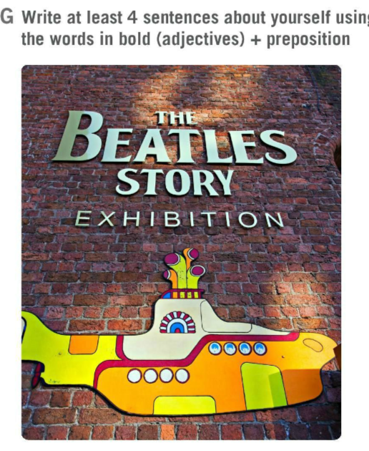
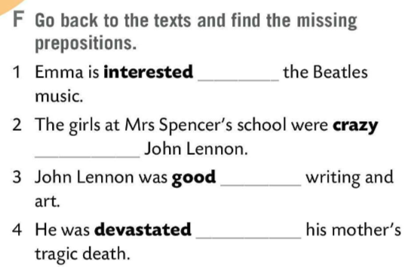
Go back to the texts and find the missing prepositions. Fill in the gaps in Task F.
Check.
Write at least four sentences about yourself using the words in bold (adjectives) + preposition.
in
about
at
Check your answers in class.
by

Slide 12
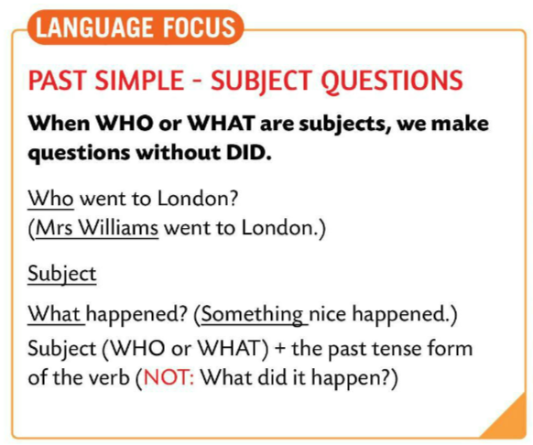
LANGUAGE FOCUS
Let’s revise.
The subject of a sentence is the person or thing that performs the action.
Subjekt je dio rečenice iz kojeg se saznaje o kome se ili čemu radi, to jest tko je vršitelj radnje.
For example:
Emma made lunch.
(Emma is the subject.)

Slide 13
LANGUAGE FOCUS
Sometimes we wonder who the subject is.
Ponekad nas zanima tko je vršitelj radnje, odnosno subjekt. Ne znamo tko vrši radnju te stoga postavljamo pitanje.
This type of question is called a subject question.
In subject questions we do NOT use the verbs do, does, and did.
Takvu vrstu pitanja nazivamo subjektnim pitanjima. U subjektnim pitanjima ne koristimo glagole do, does i did.
Who / What + verb in simple past + object
e.g.
Who went to London? (Mrs Williams)
What happened? (Something nice happened.)

Slide 14
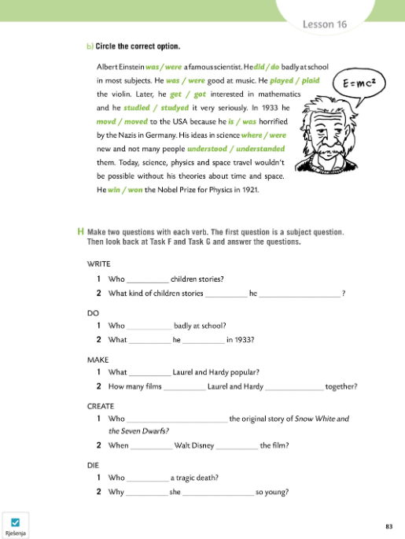
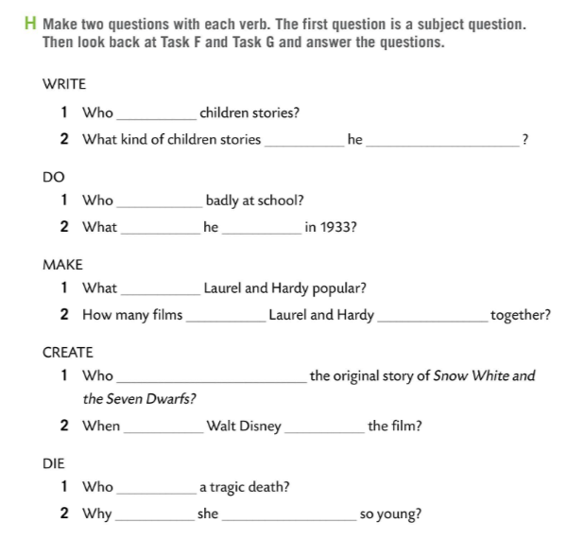
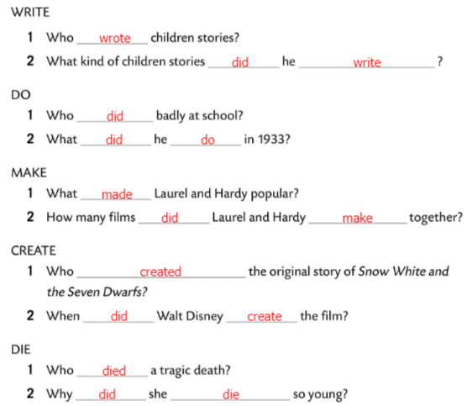
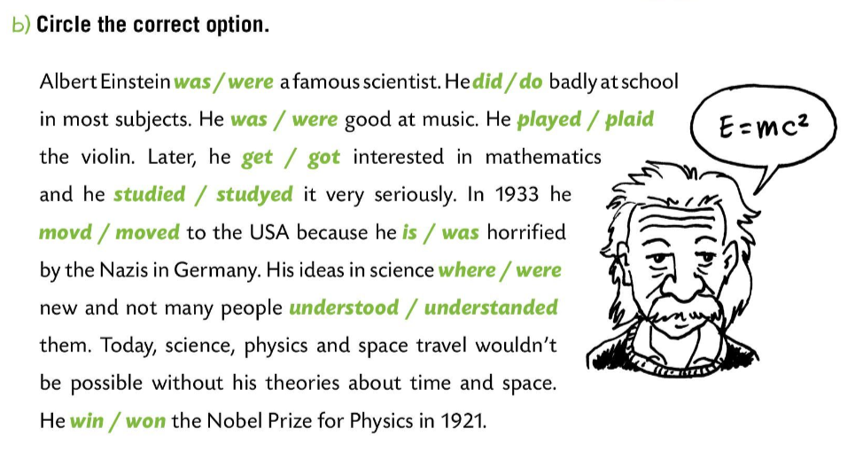
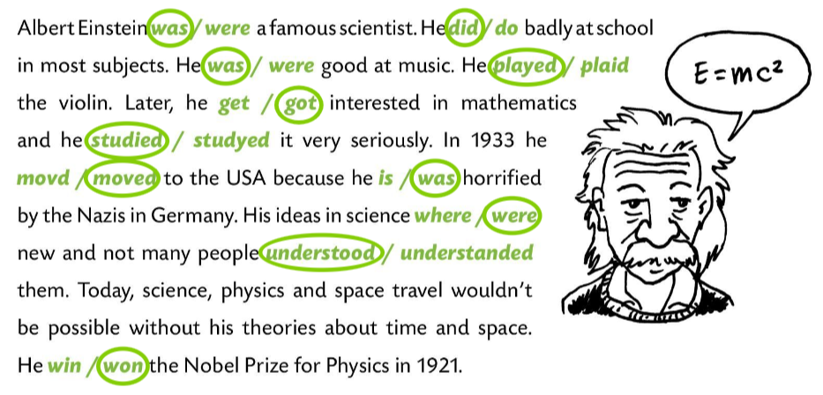
Workbook page 83.
Circle the correct option in text.
Check.
Make two questions in Task H with each verb.
The first question is a subject question.
Look back at Task F and Task G and answer the questions.
Check.

Slide 15
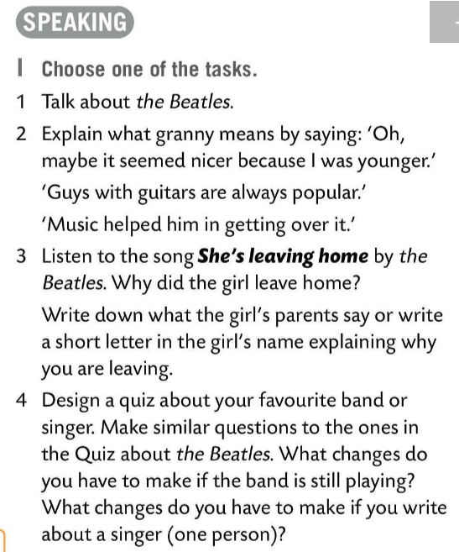
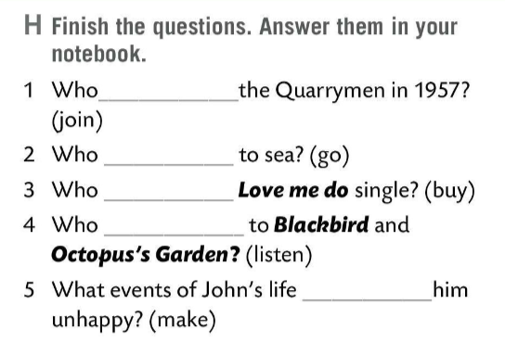
Finish the questions in Task H. Write the answers.
Check.
1 Paul McCartney joined the Quarrymen in 1957.
2 John Lennon’s father went to sea.
3 Emma’s grandpa bought their first single Love me do.
4 Emma’s mum listened to those songs when she was a baby.
5 His dad leaving to work on a ship and his mother tragically dying.
joined
went
bought
listened
made
Choose one of the speaking tasks from Task 1. Present it to the class.

Slide 16
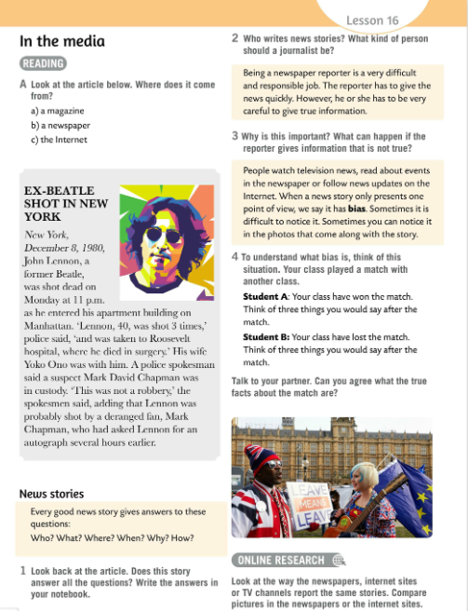
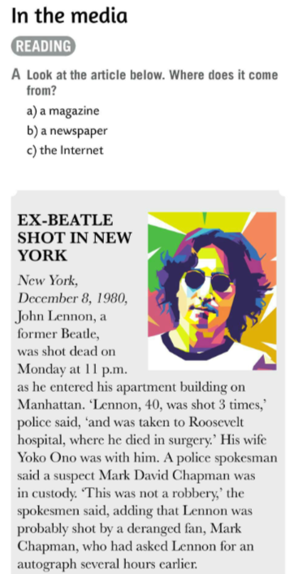
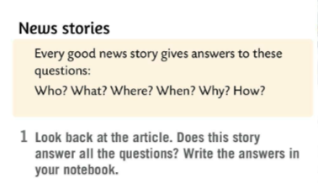
Look at the article in Task A. Where does it come from? Read the article and circle.
Check.
Every good news story gives answers to these questions: Who? What? Where? When? Why? How?
Look back at the article. Does this story answer all the questions? Write the answers.
Check in class.

Slide 17
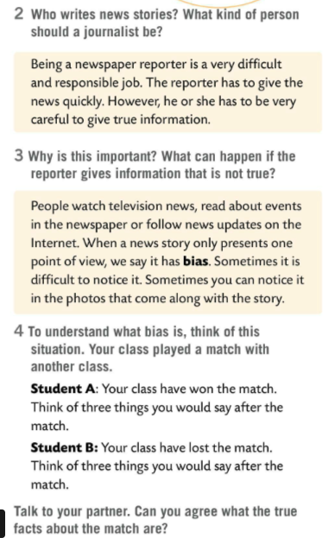
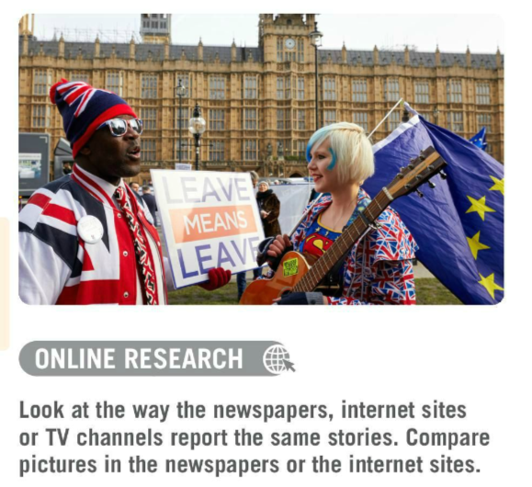
Who writes news stories? What kind of person should a journalist be?
Read the text and find out.
Why is this important? What could happen if the reporter gives information that is not true.
Read the text under the questions.
What is bias?
Look at Task 4 and read.
Talk to your partner. Can you agree what the true facts about the match are?
Research how the newspapers, Internet sites and TV channels report the same stories. Compare them and present your results in class.

Slide 18
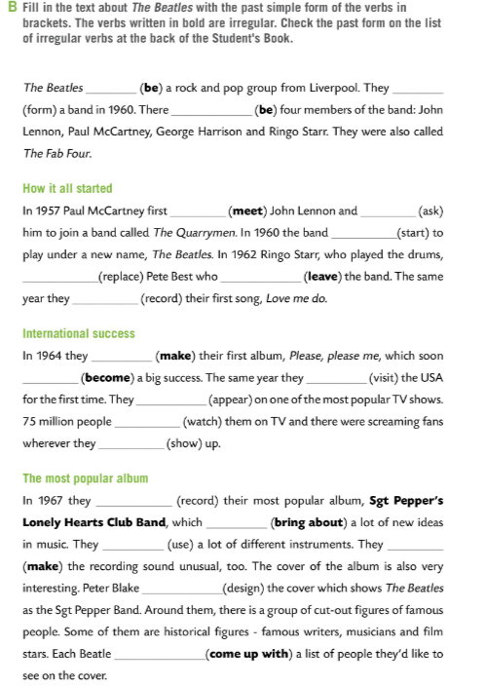
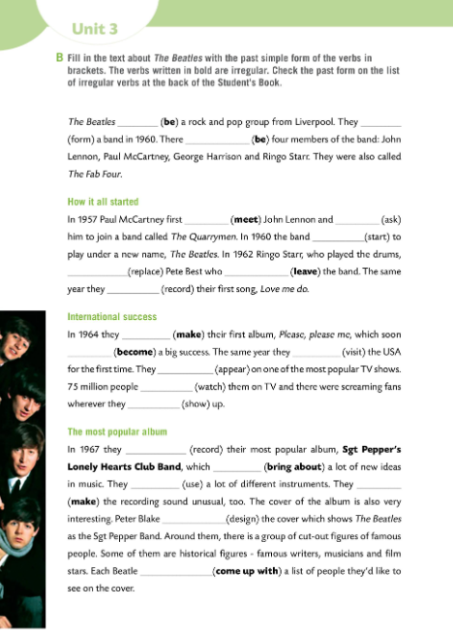
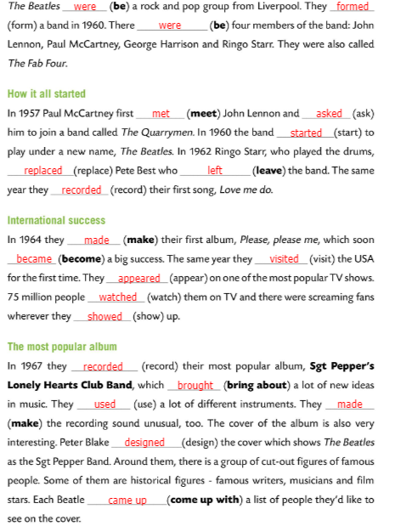
Workbook page 80.
Fill in the text in Task B with the past simple form of the verbs in brackets.
The verbs written in bold are irregular.
Check the past form on the list of irregular verbs at the back of the Student’s Book.
Check.

Slide 19
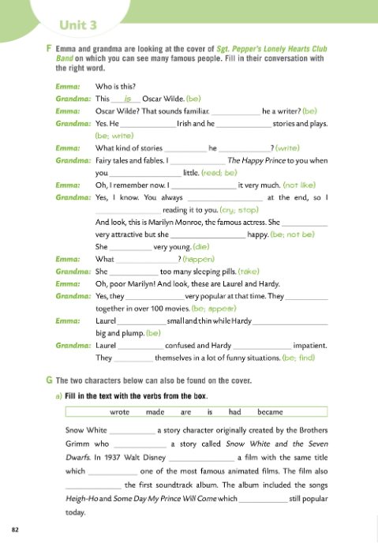
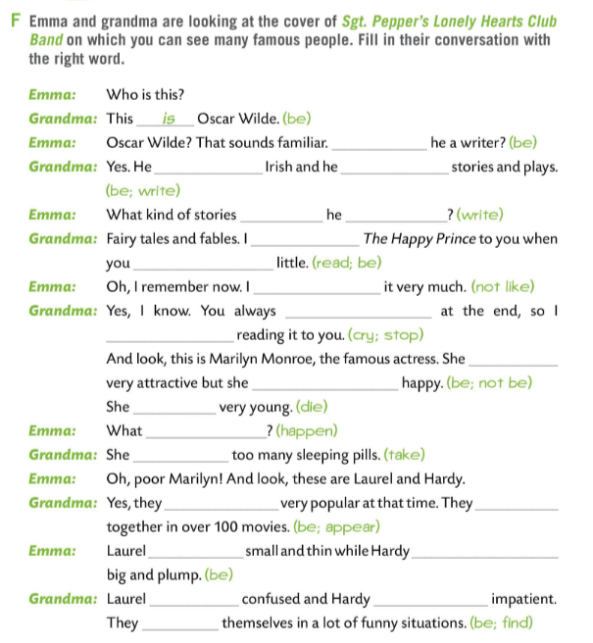
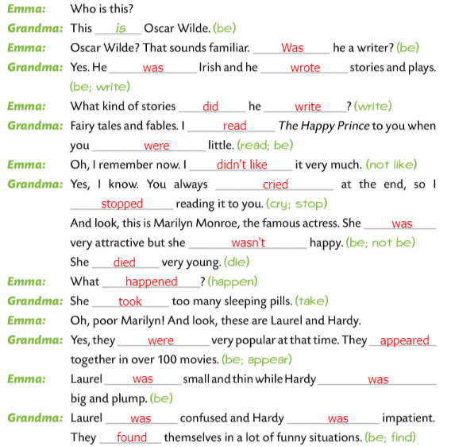
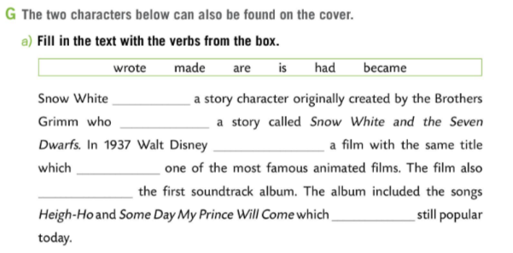
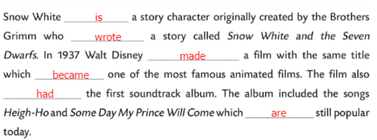
Workbook page 82.
Emma and grandma are looking at the cover of Sgt. Pepper’s Lonely Hearts Club Band on which you can see many famous people.
Fill in their conversation with the right word.
Check.
Fill in the text with the verbs from the box. The two characters below can also be found on the cover.
Check.

